Slide 1
TITLE
Event/Class Name
Program/Date

Slide 2
Why is branding so important?
Brand recognition
Consistency of message
Value of brand
Defines an institution
What are elements of a brand?
Logo
Official colors
Fonts
Style
Event/Class Name
Program/Date

Slide 3
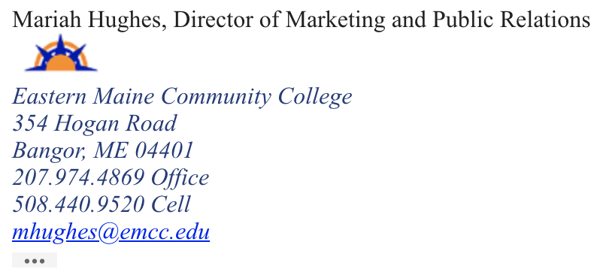
Logo
Official colors
Fonts
Style
Century Gothic
Palatino Italics
Arial
www.emcc.edu/branding-toolkit
Event/Class Name
Program/Date

