Slide 1
Title goes here
Subtitle goes here

Slide 2
Here goes the title
Welcome to Eastern Maine Community College! EMCC is a dynamic community resource, and we strive to provide the highest quality career, technical, and transfer education. We are excited to help you fulfill your personal and educational goals, and our staff is prepared to support you on every step of your journey.

Slide 3
“EMCC is a dynamic community resource, and we strive to provide the highest quality career, technical, and transfer education. We are excited to help you fulfill your personal and educational goals, and our staff is prepared to support you on every step of your journey.”

Slide 4
Here goes the title
Text goes here

Slide 5
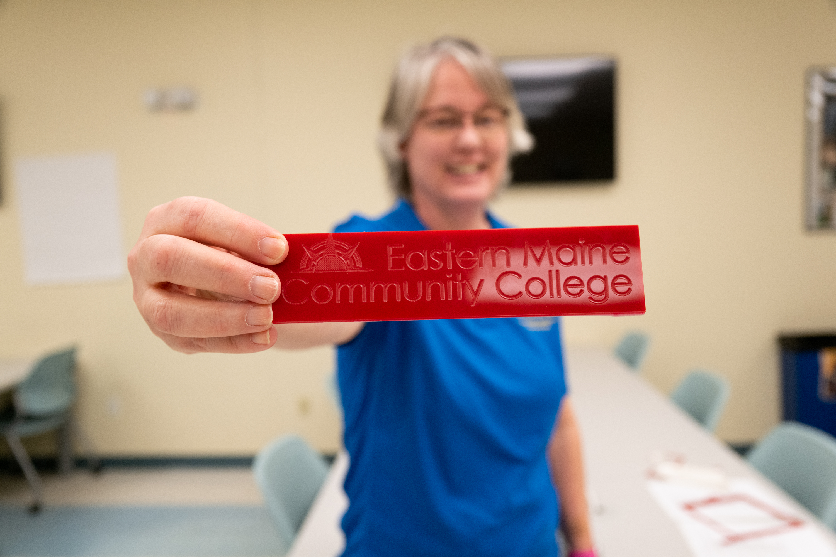
Sample text
Welcome to Eastern Maine Community College! EMCC is a dynamic community resource, and we strive to provide the highest quality career, technical, and transfer education. We are excited to help you fulfill your personal and educational goals, and our staff is prepared to support you on every step of your journey.
EMCC is a special place that has graduated thousands of citizens who are rooted in our community and contributing to the region’s economic welfare. With more than thirty degree, certificate, and short-term training programs, we’re bound to offer a program that fits your interests and needs. Check our website out, and then contact us to discuss the possibilities.
Photo caption goes here

Slide 6
Sample text
Welcome to Eastern Maine Community College! EMCC is a dynamic community resource, and we strive to provide the highest quality career, technical, and transfer education. We are excited to help you fulfill your personal and educational goals, and our staff is prepared to support you on every step of your journey.

Slide 7
Title goes here
Sample text
Welcome to Eastern Maine Community College! EMCC is a dynamic community resource, and we strive to provide the highest quality career, technical, and transfer education. We are excited to help you fulfill your personal and educational goals, and our staff is prepared to support you on every step of your journey.
EMCC is a special place that has graduated thousands of citizens who are rooted in our community and contributing to the region’s economic welfare. With more than thirty degree, certificate, and short-term training programs, we’re bound to offer a program that fits your interests and needs.

Slide 8
Title goes here
Sample text
Welcome to Eastern Maine Community College! EMCC is a dynamic community resource, and we strive to provide the highest quality career, technical, and transfer education. We are excited to help you fulfill your personal and educational goals, and our staff is prepared to support you on every step of your journey.
EMCC is a special place that has graduated thousands of citizens who are rooted in our community and contributing to the region’s economic welfare. With more than thirty degree, certificate, and short-term training programs, we’re bound to offer a program that fits your interests and needs.

